Slide 1
Lecture Four
The intersection of space and cyber

Slide 2
Class Day 2
0900 – 1000 Lecture 4: 45m Recap, Intersection of Space and Cyber
1000 – 1045 Lecture 5: 30m Cyber Warfare In Space & the Militarization of Space
1045 – 1100 Coffee Service
1100 – 1145 Lab 5: 60m Command Interceptor
1200 – 1230 Lecture 6: 30m
1230 – 1345 Lunch
1400 – 1445 Lab 6: 45m cloaking device
1445 – 1530 Lecture 6: 45m SPARTA
1530 – 1545 Coffee Service
1545 – 1630 Lab 7: 45m Code Execution
1630 – 1700 Lab 4: 30m+ IOCS
1700 – 1800 FFA lab time: 60m Go ahead and break it all!

Slide 3

Recapping Yesterday’s labs
Spinning a satellite around
Real speed of movement vs what you saw in 42
Slew rate, what it means and why
Slewing while pointing at ground for communications
Slewing while pointed at space to observe same target
JWST ~ 3 degrees per minute (this is slow)
Slewing to observe a weapon
Slewing implications
Antenna sheer
Loss of control
Damage to attitude control (actuators, fly wheels etc)

Slide 4
Recapping Yesterday’s labs: Comms, DoS encryption etc
So if I can point my antenna at a satellite and talk to it….?
You would have to know the frequency and other RF related details to close the link
You would have to know the radio salutation context
This prevents DoS
This prevents battery taxing
You would have to have the encryption if it exists
You would have to know the way the satellite takes tasks (packet construction / where file monitoring looks for things

Slide 5
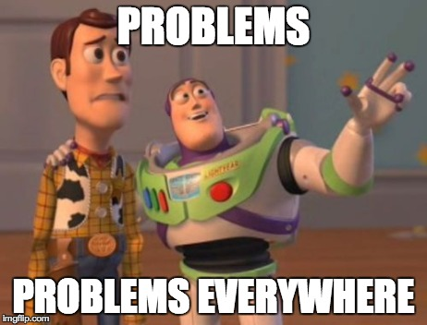

Slide 6
The Cost Problem
Lack of cost metric for cybersecurity in general
Obsession with flight heritage
Can’t make informed risk acceptance decisions
Will default to risk acceptance (plenty of flight heritage for accepting risk, for cyber not so much)
Mesh complications
Cost communication becomes more convoluted
Fixes and attacks can proliferate faster

Slide 7

The Culture Problem
The Hayabusa story
Usually, cybersecurity people are the most risk averse
Normally cybersecurity people are the more technical people in the cybersecurity discussion
The space industry is obsessed with risk
The technical perspectives of people in the industry can complicate telling the cybersecurity story

Slide 8
Supply Chain Problem(s)
Few proven vendors for buses, antennas, FPGAs and other significant components
Exceptional targetability for interdiction
High probability of widespread industry disruption if a vendor has an issue
Few proven launch providers
The threat of time
Launch windows
Long lead parts

Slide 9

Disparity Problem(s)
Space Rated Cyber: Disparity in Defense Vs Offense
Even if resources, capabilities and numbers were the same:
Defensive capabilities must be space rated
System owners will see defensive tools as a threat to their mission
Defensive tools must fail open (lest they be weaponized)
Specialization and limited supply chain and vendors allow attackers to hyper-focus on specific attack surface
Lack of defense in depth

Slide 10
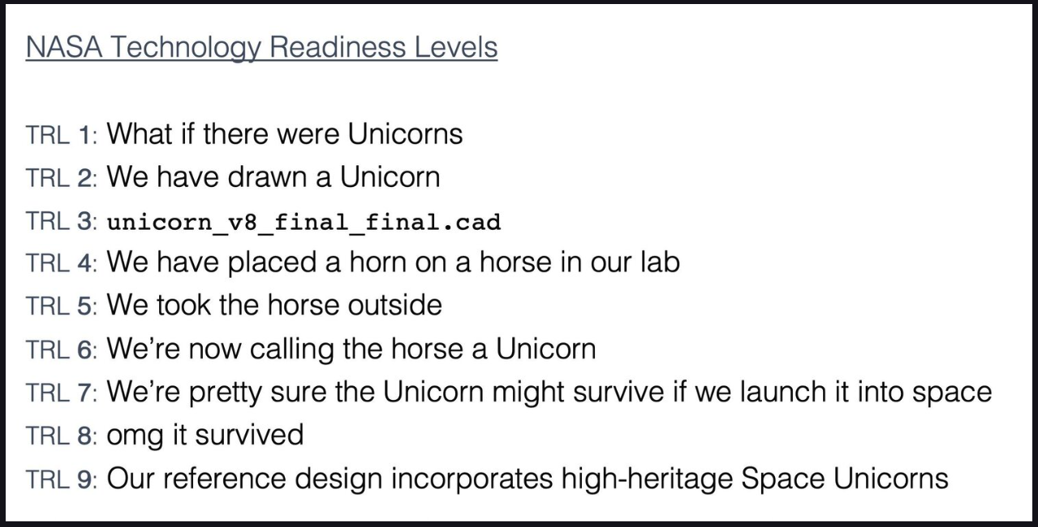

Credit to Grant Tremblay https://www.granttremblay.com/blog/trls

Slide 11
Externally Owned Attack Surface Problem
Beyond SV resident code execution, an ability to impact a space system stretches far beyond the control of owners and operators
Intra-vehicle tenants & operators
Widely varied, targetable environmental testing facilities
Vacuum chambers
Anechoic chambers
Vibration tables, etc.
Storage and transport for tests and launch

Slide 12
The Test & Evaluation Problem
RMF and IV&V is validation and evaluation not exercise of security apparatus
All other tests for space systems exercise
Torque bolt measurement vibe test analogy

Slide 13
The Adaptation Problem
All non-cyber challenges are solvable and can be evaluated / exercised in repeatable defensible manners
Cyber threat is constantly undermining preventative measures and extremely difficult to defensibly evaluate implementations.

Slide 14
The Modernization Problem
Transition to more common OS for portability and resources must be done correctly
Not just for developmental and integration ease but also leverage that technology’s security features
Other wise attack surface is worse off going from a one off unknown old piece of software to a well understood and unsecure modern one

Slide 15
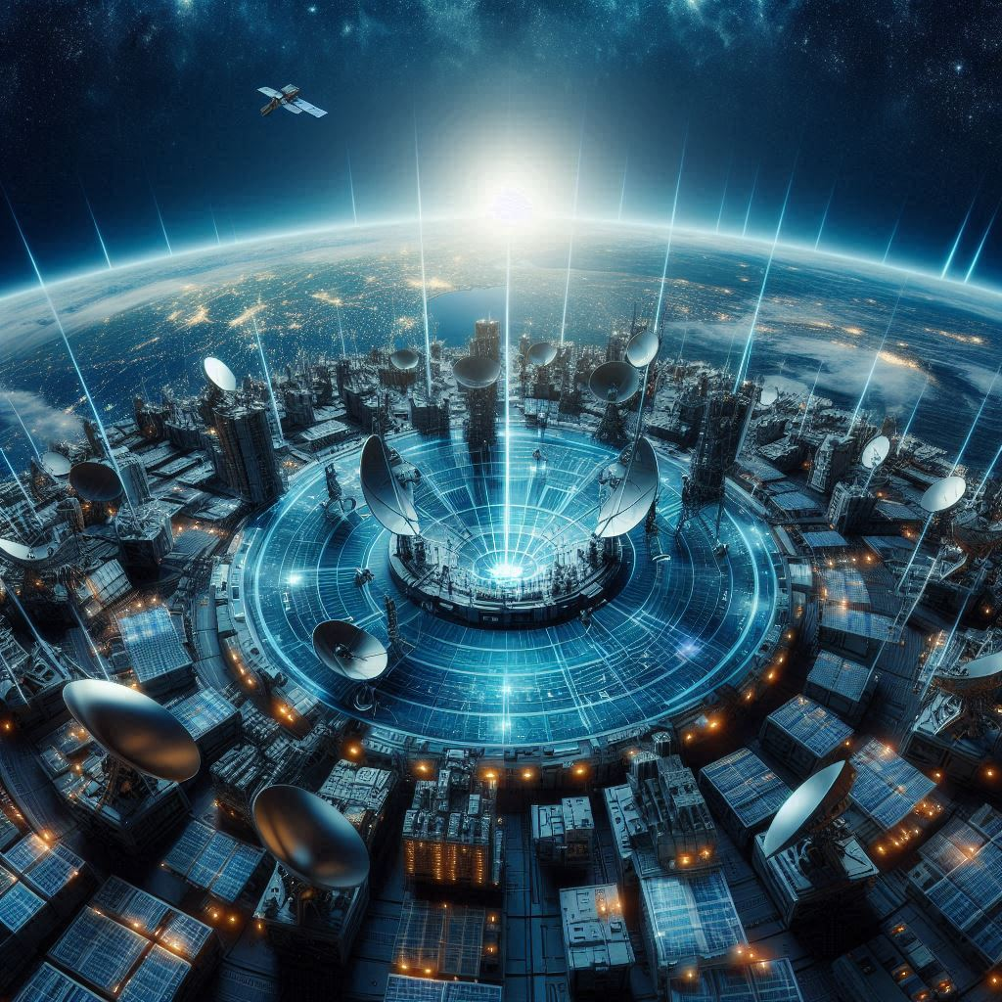
The Defense In Depth Problem
Components and systems are too trusting
Communications within space system too trusted (all encrypted so everything is fine right?)
Ground to vehicle
Vehicle to vehicle
Vehicle to ground
Computationally intensive defenses end at ground station, if present there at all

Slide 16
The Cyber Warfare Problem
Suitability aside, that is for another lecture…..
Let’s consider the compounding problems…
Bottlenecked, highly targetable supply chain
Disparity in attacker and defender challenges
Huge and impactful externally owned attack surfaces
Inadequate test & evaluation
Adaptive threats
Modernization trends
Lack of dense in depth
Add to those issues, that most attackers who would want to execute code on a satellite are nation state cyber actors performing non-collection activities…/

Slide 17
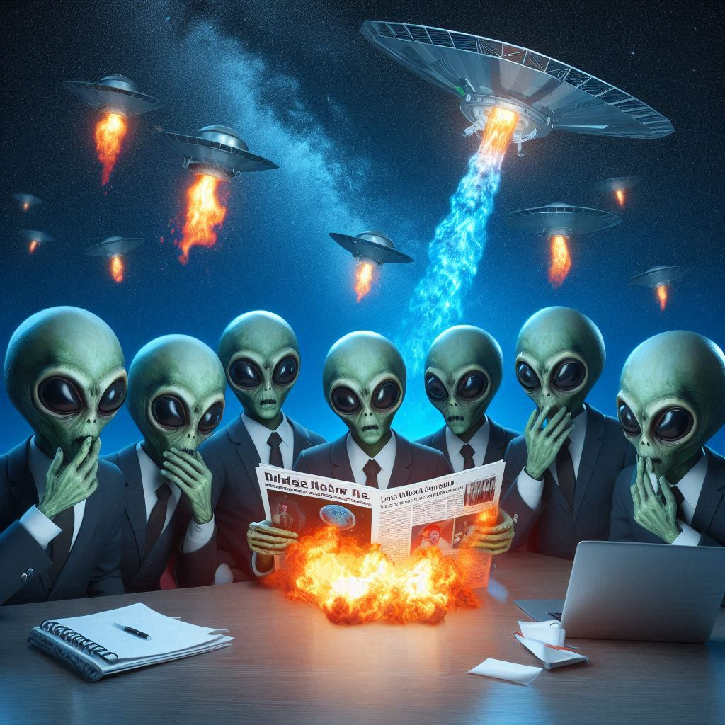
The Disclosure Problem
Most of these systems are owned or utilized by governments and militaries who are not required to, or have it in their best interest, to disclose compromises or vulnerabilities
This impacts the ability to do effective heuristic detection with large sample sets, giving a leg up to the adversary

Slide 18

The Failure Analysis Problem
Software definition of space system functions will continue
Anomaly or failure on a space vehicle might have been intentionally caused by a cyber effect needs
Cyber attacks need to be explored as a cause during failure analysis in tandem with or in high priority amongst other potential root causes

Slide 19

Space

Slide 20

Scary Story Time
You stole the satellite(s)?
Admittedly (hopefully) oversimplified example:
Task an update to the satellite(s) that replaces encryption keys
Start talking to your new satellite from your own ground station(s)
But….that’s not realistic right?.......Right?

Slide 21
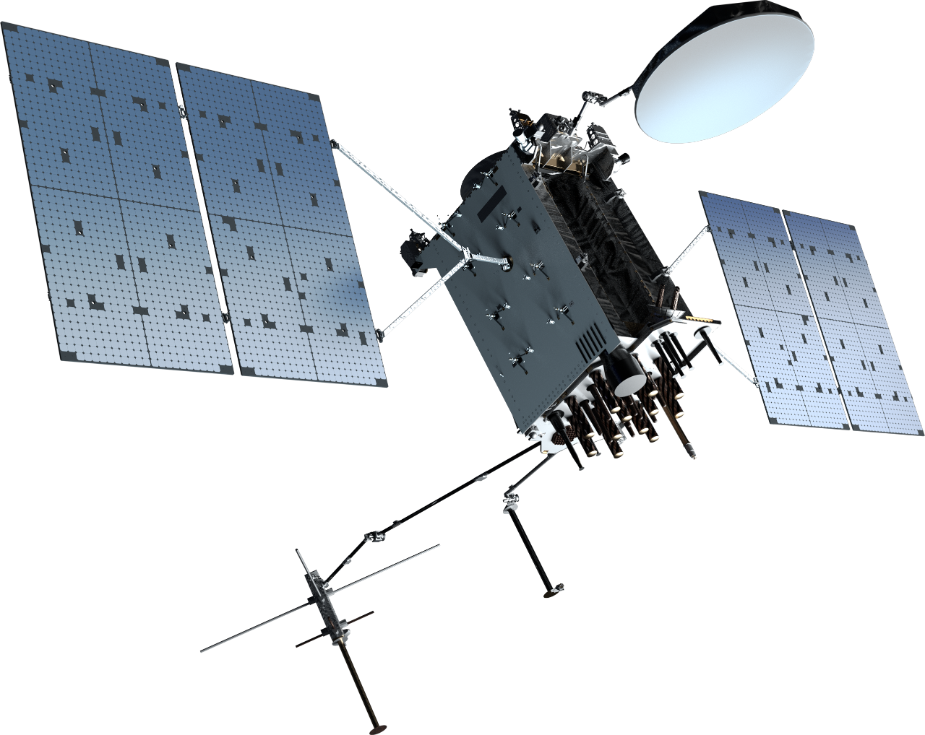
Money Talks (and so does national security)
Single Lockheed Martin GPS 3F satellite ~$250M
https://spacenews.com/u-s-space-force-buys-three-new-gps-satellites-from-lockheed-martin/
GPS constellation: Lockheed Martin is now producing a more advanced version, the GPS 3F. The company in 2018 was awarded a contract worth $7.2 billion for up to 22 GPS 3F satellites.
https://spacenews.com/air-force-to-award-7-2-billion-contract-to-lockheed-martin-for-22-gps-satellites/
GPS over time: “Reports estimate that since the 1980s, GPS satellites have helped generate nearly $1.4 trillion in economic benefits”
https://aerospace.org/article/brief-history-gps

Slide 22

Let’s run some numbers
2023: US servicemember with clearance passes detailed classified technical manuals and documents to foreign Intelligence for $5,000.
2024: US servicemember with clearance enters restricted compounds to take information and pass along to foreign intelligence for $15,000
2024: US servicemember with top secret clearance downloads and sells to foreign intelligence for $42,000
What do we think a foreign government would be willing to pay to instantly own the GPS constellation? A million? Ten million? A billion?
Also, we’d then just shoot them down, right? No. Remember, you’d pollute the orbit with hypersonic shrapnel.

Slide 23
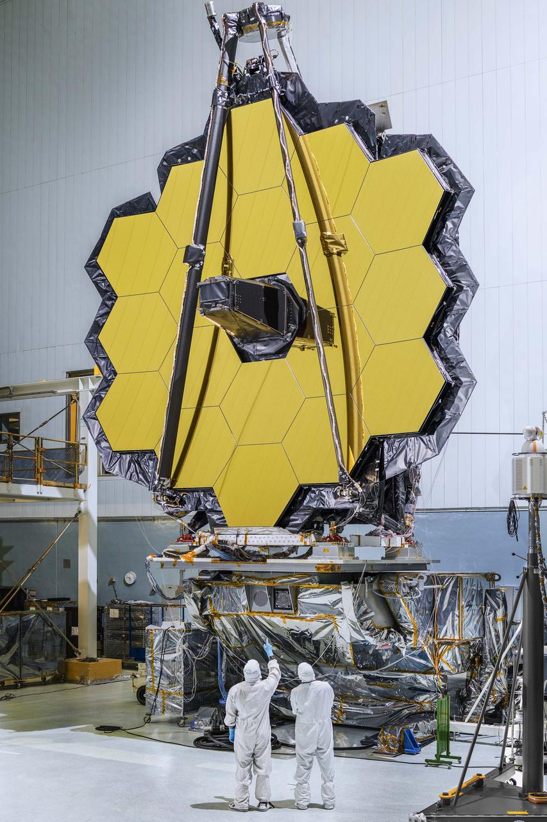
Not convinced? How about a softer target?
James Webb Space Telescope (JWST)
Cost: $10 Billion
https://www.space.com/21925-james-webb-space-telescope-jwst.html
Really big infrared sensor
Same questions apply.

Slide 24
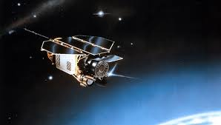
RoSat
In 1998 a joint German / US X-ray sensor satellite called ROSAT was compromised.
Allegedly involved a foreign actor gaining access to Goddard Space Flight Center via social engineering and poorly configured FTP services.
Ultimately the actor was able to access a server that contained RoSat mission files. Algorithms were changed in those files that resulted in the satellite pointing towards the sun and overheating.
The team was able to identify the issue and correct the satellites positioning but without knowing it was the result of cyber activity.
Later it appears the actor came back, this time pointing the imager directly at the sun and permanently damaging it.

Slide 25
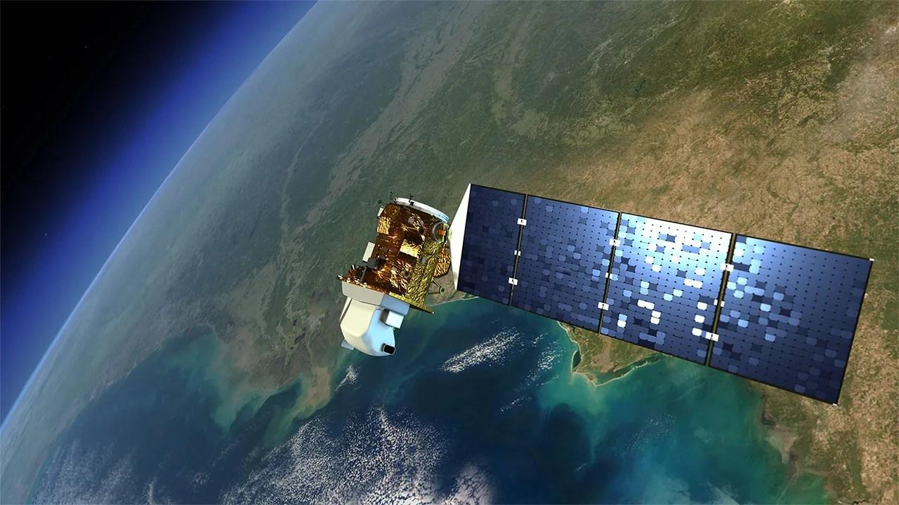
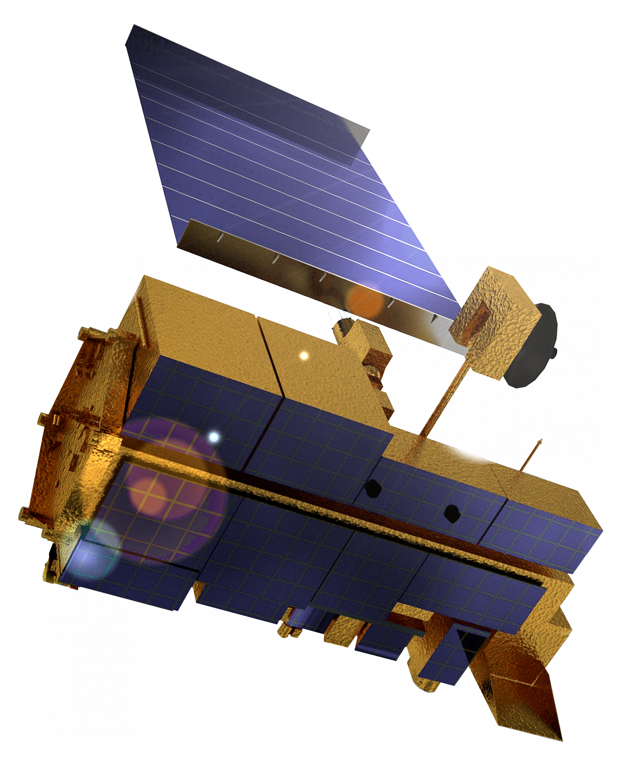
Landsat / Terra Sat
October 2007 and July 2008, NASA-managed Landsat-7 satellite experienced 12 or more minutes of interference
June and October 2008, Terra AM-1 satellite was disrupted for two minutes and nine minutes respectively
The malicious activity was tied to a compromised ground station in Norway via local internet
According to NASA the hackers had the full ability to send legitimate command and control tasking to the satellites from the compromised ground station

Slide 26
That disclosure problem…
Skynet
Allegedly, a GROUP of computer hackers suspected of seizing control of a British military communications satellite using a home computer, triggering a "frenetic" security alert, has been traced to the south of England.
Allegedly, a security source said that, up to a month ago, the hackers found a "cute way" into the control system for one of the Ministry of Defence's Skynet satellites and "changed the characteristics of channels used to convey military communications, satellite television and telephone calls".
Allegedly, the facts as reported are as follows: Two weeks ago, British aerospace authorities noticed an irregularity in the position of one of their satellites, a military communications satellite belonging to a group of four known as Skynet satellites. Shortly thereafter, they received an anonymous message demanding money in exchange for control over the satellites guidance systems. "This is a nightmare scenario," an "intelligence source" told Reuters. "This is not just a case of computer nerds mucking about," said another. "This is very, very serious and the blackmail threat has made it even more serious.“
NOAA
2014 compromise of multiple aspects of their weather networks including space systems
Delayed reporting the breach and declined to comment on the extent of impacts of the compromise

Slide 27
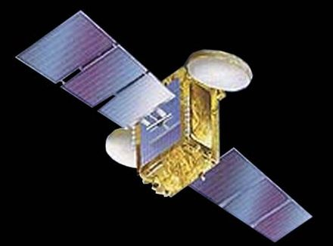
But…….INSAT-4B Happened
Credit to Jeffrey Carr and his Forbes article:
On July 7, 2010, a power glitch in the solar panels of India's INSAT-4B satellite resulted in 12 of its 24 transponders shutting down
India's Space Research Organization was a Siemens customer
According to the resumes of two former engineers who worked at the ISRO's Liquid Propulsion Systems Centre, the Siemens software in use is Siemens S7-400 PLC and SIMATIC WinCC, both of which will activate the Stuxnet worm.
https://www.forbes.com/sites/firewall/2010/09/29/did-the-stuxnet-worm-kill-indias-insat-4b-satellite/?sh=2618bb7a127d
Regardless of conjecture and intended purpose, is proof that a state cyber campaign could effectively target space assets. Also, only example of true malicious code execution.

Slide 28
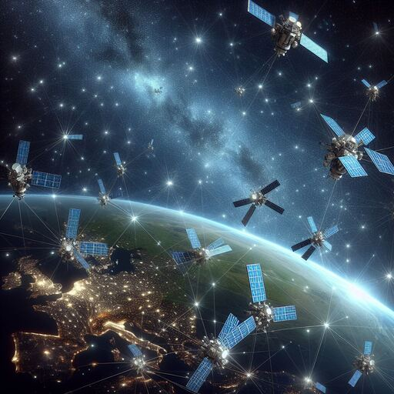
Constellations and Meshes: Mitigation or Risk?
Pros
Additional satellites can improve resilience
Mesh network makes communications and tasking more resilient
Persistence more easily achieved
Less ground infrastructure
Cons
Aggregation of risk
Enemy needs less infrastructure on the ground
Attacks can spread more quicky and have higher payoff

Slide 29

The Expectation of Protection
Realistic:
Borders
Airspace
National Waters
Unrealistic:
Cyber
Space

Slide 30
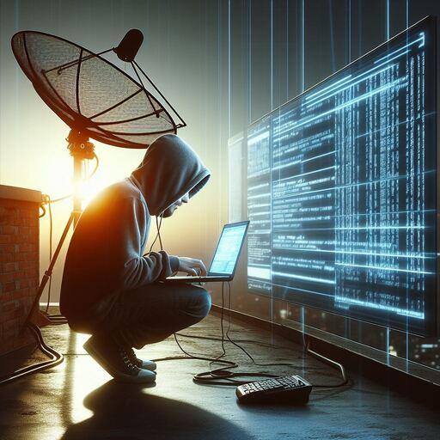
The Age of Space Conflict Asymmetry
WHAT WAS: Near peer adversaries capable of spaceflight contesting dominance of the space domain
WHAT IS: Anyone with a laptop and access to the internet has an ability to participate

